Slide 1
Simplifying PowerShell
dbatools + dbachecks
Rob Sewell, MVP, DBA
Chrissy LeMaire, MVP, DBA

Slide 2




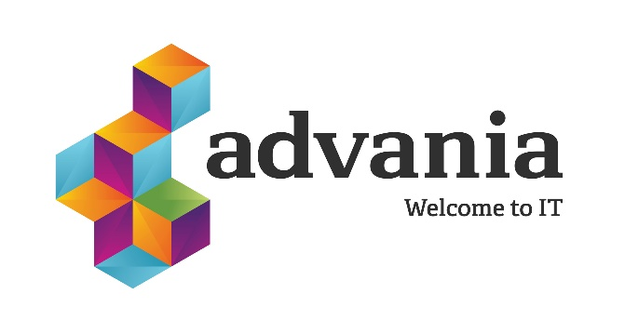


Thanks to our sponsors:

Slide 3

Chrissy LeMaire
SQL Data Pro – Since 1999
DBA, Developer and Architect
PowerShell MVP – Since 2015
Most PowerShell work revolves around SQL Server with a bit of VMware & SharePoint
Sr. Systems Engineer
GDIT @ NATO Special Ops HQ
Best Speaker & Best Lightning Talk - #SqlSatDublin
Best Speaker with dbatools teammate Rob Sewell
/in/chrissylemaire
@cl
netnerds.net

Slide 4
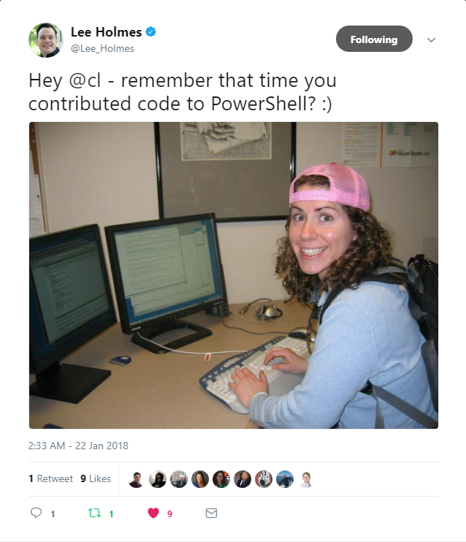
PowerShell since 2005
❤️

Slide 5

Rob Sewell
Sewells Consulting Limited
PowerShell Automator, PowerShell Trainer, Database DevOps
MVP, Speaker and Organizer
Half a Best Speaker!!, PowerShell and SQL user groups, national and international events
Consultant, Sewells Consulting Ltd
dbatools dbareports dbachecks
Loves Pester. Always available for help via the usual social media channels
/in/robsewellsqldba
@sqldbawithbeard
robsewell.info
Notes:
This is Rob He runs his own company providing PowerShell magic, PowerShell Training and Database DevOps consultancy he’s a speaker and organiser for SQL South West, SQL Saturday Exeter, PSDayUK, PSConf.eu, PSConfasia and conference volunteer at SQL Bits

Slide 6
Agenda
intro to dbatools
dbatools demo
intro to dbachecks
dbachecks demo

Slide 7
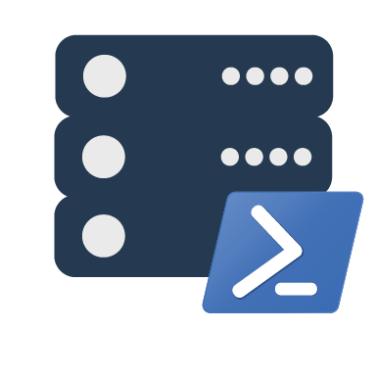
dbatools orientation
the community module
Notes:
Intro to dbatools

Slide 8
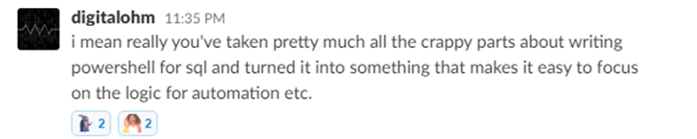
Basically..

Slide 9
Support
SQL Server 2000 – 2017 *
Express – Enterprise Edition
Clustered and stand-alone instances
Windows and SQL authentication
Default and named instances
Multiple instances on one server
Notes:
* Azure

Slide 10
System Requirements
MINIMUM
RECOMMENDED
Client
PowerShell v3
Server
SQL Server 2000
No PowerShell for pure SQL commands
Remoting enabled for Windows commands
Client
PowerShell v5.1
Server
SQL Server 2008 R2+
Notes:
SQL Server 2000 – think “Can SSMS connect?”

Slide 11
Install is easy
POWERSHELL GALLERY
Install-Module dbatools
Install-Module dbatools –Scope CurrentUser
WEBSITE
dbatools.io/download
OFFLINE
dbatools.io/offline

Slide 12
How to Get-Help
Extensive documentation within each command
Get-Help Start-DbaMigration -Detailed
Extensive documentation on dbatools.io
dbatools.io/Test-DbaLastBackup dbatools.io/Set-DbaSpn
Some commands have videos
dbatools.io/youtube

Slide 13
demo time!
Notes:
# Set some vars
$new = "localhost\sql2016"
$old = $instance = "localhost"
$allservers = $old, $new
# Alternatively, use Registered Servers?
Get-DbaRegisteredServer -SqlInstance $instance | Out-GridView
# Quick overview of commands
Start-Process https://dbatools.io/commands
# You've probably heard about how easy migrations can be with dbatools. Here's an example
$startDbaMigrationSplat = @{
Source = $old
Destination = $new
BackupRestore = $true
NetworkShare = 'C:\temp'
NoSysDbUserObjects = $true
NoCredentials = $true
NoBackupDevices = $true
NoEndPoints = $true
}
Start-DbaMigration @startDbaMigrationSplat -Force | Select * | Out-GridView
# Use Ola Hallengren's backup script? We can restore an *ENTIRE INSTNACE* with just one line
Get-ChildItem -Directory \\workstation\backups\sql2012 | Restore-DbaDatabase -SqlInstance $new
# Nowadays, we don't just backup databases. Now, we're backing up logins
Export-DbaLogin -SqlInstance $instance -Path C:\temp\logins.sql
Invoke-Item C:\temp\logins.sql
# And Agent Jobs
Get-DbaAgentJob -SqlInstance $old | Export-DbaScript -Path C:\temp\jobs.sql
# What if you just want to script out your restore?
Get-ChildItem -Directory \\workstation\backups\subset\ | Restore-DbaDatabase -SqlInstance $new -OutputScriptOnly -WithReplace | Out-File -Filepath c:\temp\restore.sql
Invoke-Item c:\temp\restore.sql
# Complaint: Already have a library of Profiler templates
# Answer: Convert them instantly to Sessions (h/t Jonathan Kehayias)
Get-DbaTrace -SqlInstance sql2014 | ConvertTo-DbaXESession | Start-DbaXESession
# Easily import
Get-DbaXESessionTemplate | Out-GridView -PassThru | Import-DbaXESessionTemplate -SqlInstance $servers | Start-DbaXESession
# Testing your backups is crazy easy!
Start-Process https://dbatools.io/Test-DbaLastBackup
Test-DbaLastBackup -SqlInstance $old | Out-GridView
# But what if you want to test your backups on a different server?
Test-DbaLastBackup -SqlInstance $old -Destination $new | Out-GridView
# Know how snapshots used to be a PITA? Now they're super easy
New-DbaDatabaseSnapshot -SqlInstance $new -Database db1 -Name db1_snapshot
Get-DbaDatabaseSnapshot -SqlInstance $new
Get-DbaProcess -SqlInstance $new -Database db1 | Stop-DbaProcess
Restore-DbaFromDatabaseSnapshot -SqlInstance $new -Database db1 -Snapshot db1_snapshot
Remove-DbaDatabaseSnapshot -SqlInstance $new -Snapshot db1_snapshot # or -Database db1
# We evaluated 37,545 SQL Server stored procedures on 9 servers in 8.67 seconds!
$new | Find-DbaStoredProcedure -Pattern dbatools
# Have an employee who is leaving? Find all of their objects.
$allservers | Find-DbaUserObject -Pattern ad\jdoe | Out-GridView
# Find detached databases, by example
Detach-DbaDatabase -SqlInstance $instance -Database AdventureWorks2012
Find-DbaOrphanedFile -SqlInstance $instance | Out-GridView
# View and change service account
Get-DbaSqlService -ComputerName workstation | Out-GridView
Get-DbaSqlService -ComputerName workstation | Select * | Out-GridView
Get-DbaSqlService -Instance SQL2016 -Type Agent | Update-DbaSqlServiceAccount -Username 'Local system'
# Check out how complete our sp_configure command is
Get-DbaSpConfigure -SqlInstance $new | Out-GridView
Get-DbaSpConfigure -SqlInstance $new -ConfigName XPCmdShellEnabled
# Easily update configuration values
Set-DbaSpConfigure -SqlInstance $new -ConfigName XPCmdShellEnabled -Value $true
# XEs Read and watch
Get-DbaXESession -SqlInstance $new -Session system_health | Read-DbaXEFile
# Reset-DbaAdmin
Reset-DbaAdmin -SqlInstance $instance -Login sqladmin -Verbose
Get-DbaDatabase -SqlInstance $instance -SqlCredential (Get-Credential sqladmin)
# sp_whoisactive
Install-DbaWhoIsActive -SqlInstance $instance -Database master
Invoke-DbaWhoIsActive -SqlInstance $instance -ShowOwnSpid -ShowSystemSpids
# Diagnostic query!
$instance | Invoke-DbaDiagnosticQuery -UseSelectionHelper | Export-DbaDiagnosticQuery -Path $home
Invoke-Item $home
# Ola, yall
$instance | Install-DbaMaintenanceSolution -ReplaceExisting -BackupLocation C:\temp -InstallJobs
# Get db space AND write it to table
Get-DbaDatabaseFile -SqlInstance $instance | Out-GridView
Get-DbaDatabaseFile -SqlInstance $instance -IncludeSystemDB | Write-DbaDataTable -SqlInstance $instance -Database tempdb -Table DiskSpaceExample -AutoCreateTable
Invoke-DbaSqlcmd -ServerInstance $instance -Database tempdb -Query 'SELECT * FROM dbo.DiskSpaceExample' | Out-GridView
# History
Get-Command -Module dbatools *history*
# More histories
Get-DbaAgentJobHistory -SqlInstance $instance | Out-GridView
Get-DbaBackupHistory -SqlInstance $new | Out-GridView
# Test/Set SQL max memory
$allservers | Get-DbaMaxMemory
$allservers | Test-DbaMaxMemory | Format-Table
$allservers | Test-DbaMaxMemory | Where-Object { $_.SqlMaxMB -gt $_.TotalMB } | Set-DbaMaxMemory -WhatIf
Set-DbaMaxMemory -SqlInstance $instance -MaxMb 1023
# Reads trace files - default trace by default
Read-DbaTraceFile -SqlInstance $instance | Out-GridView
# don't have remoting access? Explore the filesystem. Uses master.sys.xp_dirtree
Get-DbaFile -SqlInstance $instance
Get-DbaFile -SqlInstance $instance -Depth 3 -Path 'C:\Program Files\Microsoft SQL Server' | Out-GridView
New-DbaSqlDirectory -SqlInstance $instance -Path 'C:\Program Files\Microsoft SQL Server\MSSQL14.MSSQLSERVER\test'
# Out-GridView madness <3
Get-DbaDatabase -SqlInstance $old | Out-GridView -PassThru | Copy-DbaDatabase -Destination $new -BackupRestore -NetworkShare \\workstation\c$\temp -Force
# We've even got our own config system!
Get-DbaConfig | Out-GridView
# Check out our logs directory, so Enterprise :D
Invoke-Item (Get-DbaConfig -FullName path.dbatoolslogpath).Value
# Want to see what's in our logs?
Get-DbatoolsLog | Out-GridView
# Need to send us diagnostic information? Use this support package generator
New-DbatoolsSupportPackage

Slide 14
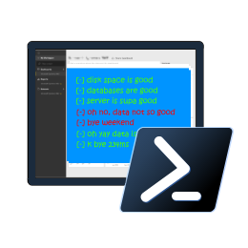
Introducing dbachecks
the new community module

Slide 15
Blog posts & Twitter
dbachecks.io/intro
dbachecks.io/deepdive
dbachecks.io/blog
dbachecks.io/twitter

Slide 16
System Requirements
MINIMUM
RECOMMENDED
Client
PowerShell v4
Modules
dbatools
Pester
PSFramework
Client
PowerShell v5.1

Slide 17
Install is easy
POWERSHELL GALLERY
Install-Module dbachecks
Install-Module dbachecks –Scope CurrentUser
* Automatically installs required modules

Slide 18
Need an offline install?
POWERSHELL GALLERY FROM CONNECTED WORKSTATION
Save-Module dbachecks, dbatools, Pester, PSFramework

Slide 19

Join our Slack channel
Invite yourself to Slack
dbatools.io/slack
Join #dbachecks and #dbatools
Ask questions, possibly get answers in real time ;)

Slide 20
demo time!
Notes:
# To get started
Install-Module Pester -SkipPublisherCheck
Update-Module Pester -Force
Import-Module Pester -Force
# Perform a basic check
Invoke-DbcCheck -SqlInstance localhost\sql2017 -Checks SuspectPage, LastBackup
# How do we know which checks exist and if we should specify SqlInstance or ComputerName?
Get-DbcCheck | Out-GridView
Get-DbcCheck *disk*
Invoke-DbcCheck -SqlInstance localhost\sql2017 -Checks ValidDatabaseOwner
# Make a server list
$servers = "localhost\sql2017","localhost\sql2016"
$servers = Get-DbaRegisteredServer -SqlInstance localhost\sql2017
$servers = Get-Content C:\scripts\servers.txt
$servers = Get-ADComputer -Filter "name -like '*sql*'"
# Run statically - set once
Set-DbcConfig -Name app.sqlinstance -Value $servers
Set-DbcConfig -Name app.computername -Value localhost
Invoke-DbcCheck -Checks SuspectPage, LastBackup
Invoke-DbcCheck -Checks DiskCapacity
# Or Dynamically
Invoke-DbcCheck -SqlInstance $sqlservers -Checks SuspectPage, LastBackup
Invoke-DbcCheck -ComputerName $computers -Checks DiskCapacity
# How do we know which configs exist?
Get-DbcConfig | Out-GridView
# A little more advanced which runs all Database Checks except backups - also passes an alternative credential
Invoke-DbcCheck -Check Database -ExcludeCheck Backup -SqlInstance localhost\sql2016 -SqlCredential (Get-Credential sqladmin)
# Run checks and export its JSON
Invoke-DbcCheck -SqlInstance localhost\sql2017 -Checks SuspectPage, LastBackup -Show Summary -PassThru |
Update-DbcPowerBiDataSource
# You can also split it up by environment
Invoke-DbcCheck -SqlInstance $prod -Checks LastBackup -Show Summary -PassThru | Update-DbcPowerBiDataSource -Environment Production
Invoke-DbcCheck -SqlInstance $dev -Checks LastBackup -Show Summary -PassThru | Update-DbcPowerBiDataSource -Environment Development
Invoke-DbcCheck -SqlInstance $test -Checks LastBackup -Show Summary -PassThru | Update-DbcPowerBiDataSource -Environment Test
# Launch Power BI then hit refresh
Start-DbcPowerBi
# Prefer email? Also easy:
Invoke-DbcCheck -SqlInstance localhost\sql2017 -Checks SuspectPage, LastBackup -OutputFormat NUnitXml -PassThru |
Send-DbcMailMessage -To clemaire@dbatools.io -From nobody@dbachecks.io -SmtpServer localhost
# Have specific requirements and want to add your own checks? Add your own repo! *
Set-DbcConfig -Name app.checkrepos -Value C:\temp\checks -Append
# What does our repo look like?
Invoke-Item "$(Split-Path (Get-Module dbachecks).Path)\checks"
Start-Process https://dbachecks.io/wiki
# Set a global, persistent credential
Set-DbcConfig -Name app.sqlcredential -Value (Get-Credential sqladmin)

Slide 21

Questions!

Slide 22
Thank you!

Slide 23
SqlServer vs dbatools
SqlServer is officially supported by Microsoft
SqlServer is C# cmdlet based
SqlServer is closed-source & must be fixed and enhanced by Microsoft
SqlServer has fewer resources
dbatools has unofficial, community-based support
dbatools is PowerShell function based
dbatools is open source – fix or enhance yourself or ask us
dbatools has 100+ contributors
Notes:
Mention that SqlServer is successor to SQLPS

